Slide 1

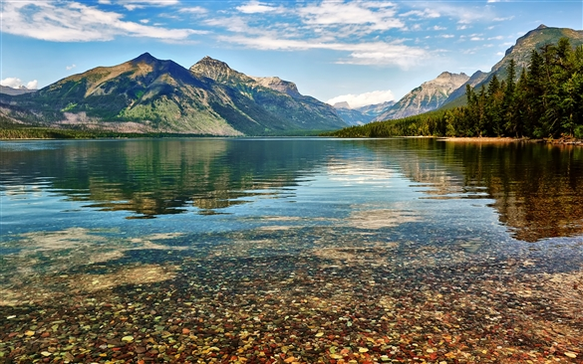
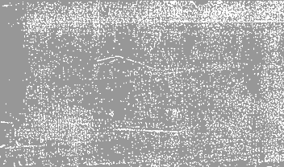
SinGAN:
Learning a Generative Model from a Single Natural Image

Slide 2
Reference paper
Goal
Setup
Applications
Generate new realistic natural images.
High variability.
Keep global structure and fine textures of the training image.
Pyramid of fully
convolutional GANs,
each responsible for
learning the patch
distribution at a
different scale of the
image.
Random Sample
Super-resolution
Paint-to-image
Harmonization
Editing
Single image animation

Slide 3
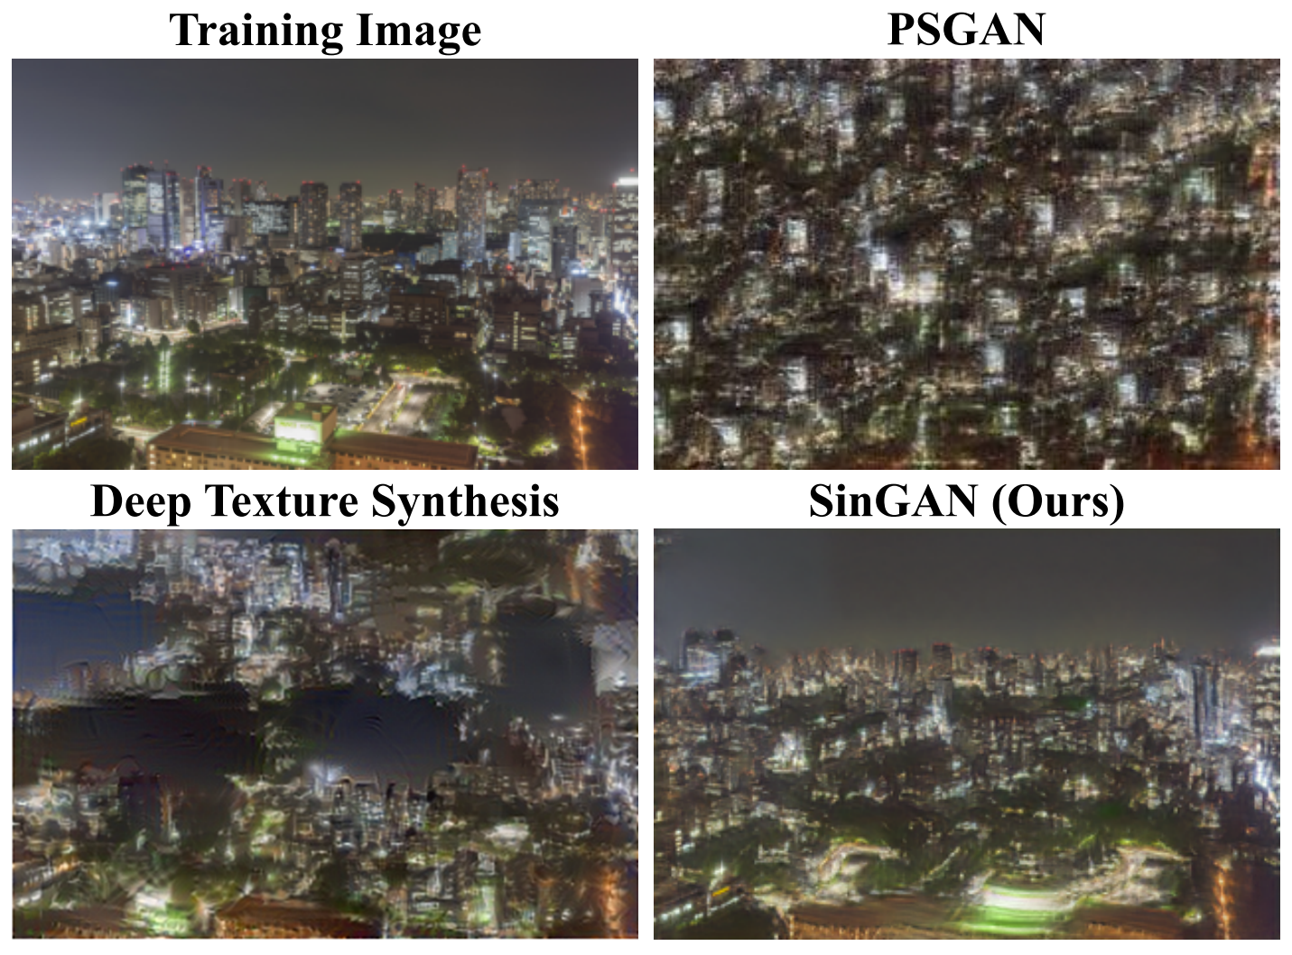
Related works
Single image deep models
Overfit a deep model on a single training sample → Task-specific
GAN-based model for a single natural image by Shocher et al. → The generation is conditioned on the input image and cannot be used to draw random samples.
Unconditional single image GANs for texture generation → Cannot generate realistic samples if trained on non-texture images.
Generative models for image manipulation
GAN-based methods for many image manipulation tasks → Trained on class specific datasets
Figure: Single image texture generation

Slide 4

Novelty
Machine learning has shown a great potential in the medical field, since it allowed to achieve fast and very accurate diagnoses of severe disorders.
There are not large datasets available, so by training a deep network from scratch we would need to face the problem of overfitting.
Use SinGAN to increase the size of the available datasets, by generating new medical images to be used in several machine learning tasks.

Slide 5
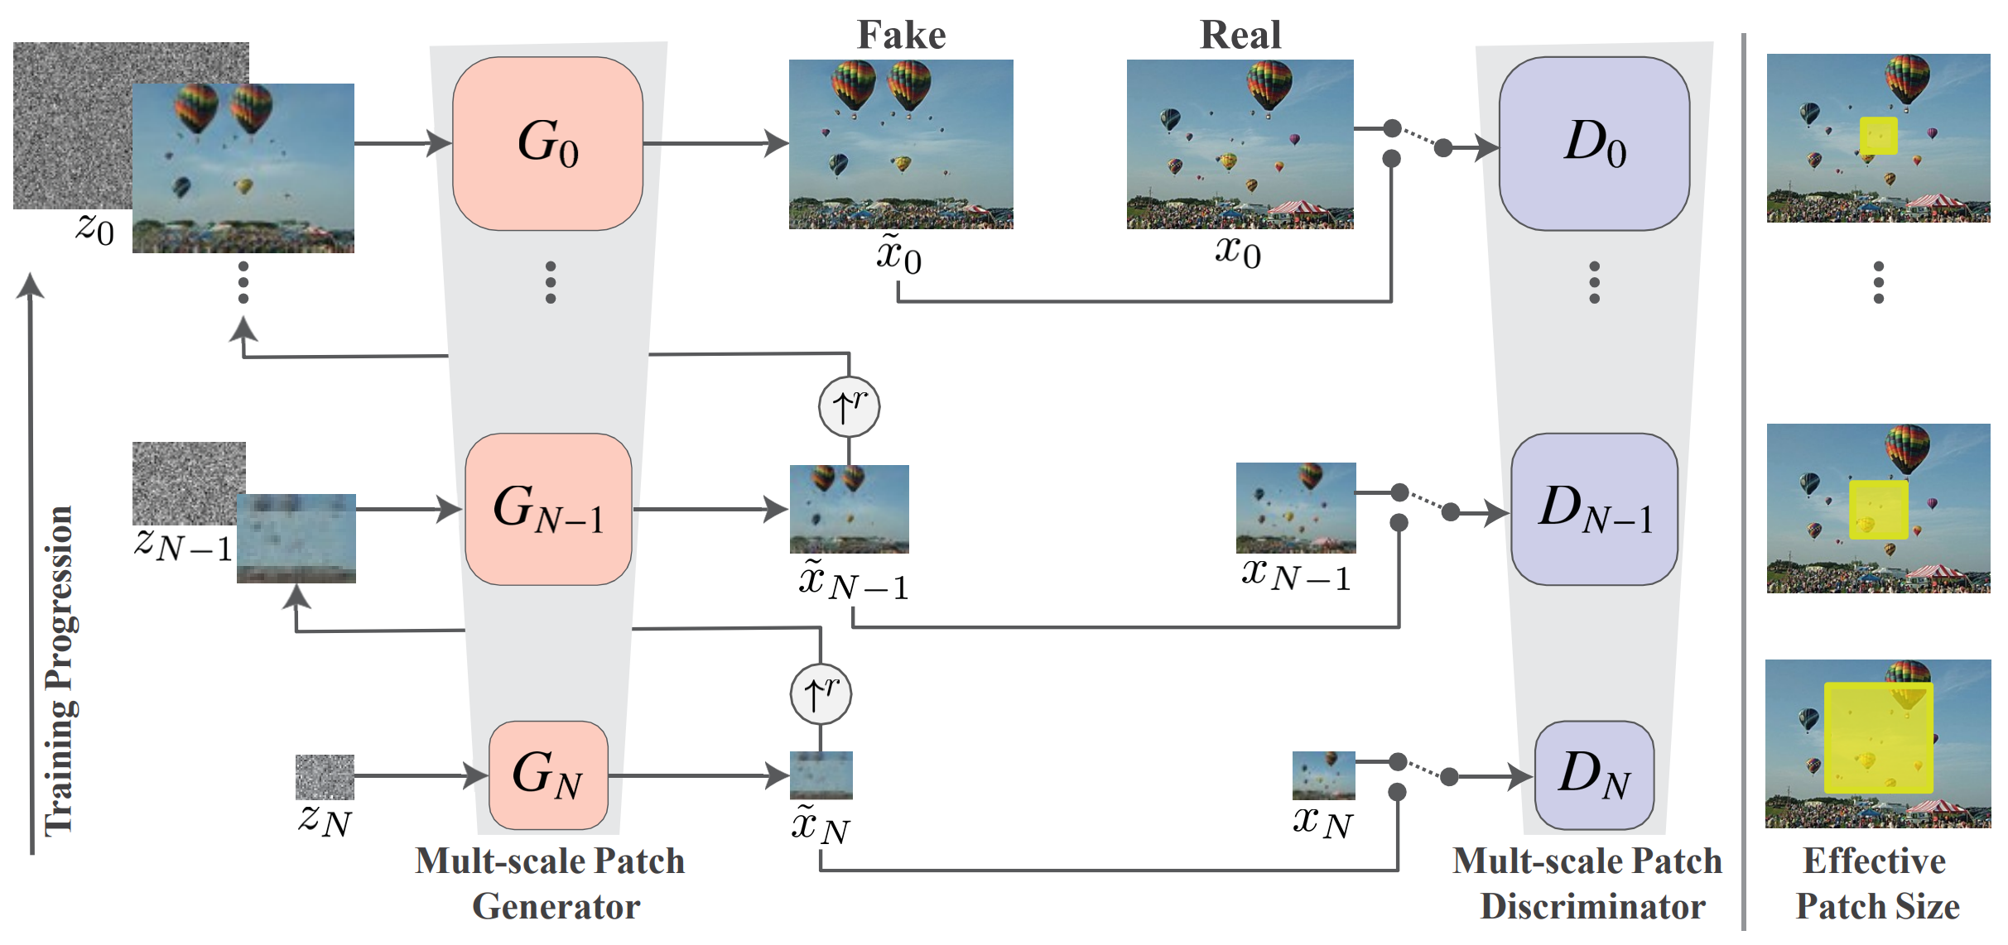
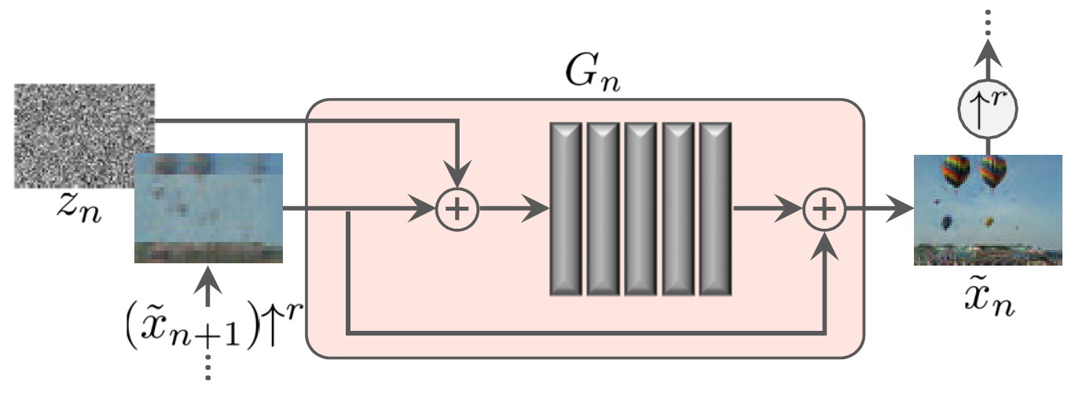
SinGAN’s architecture
Multi-scale
pipeline
Single scale generation

Slide 6
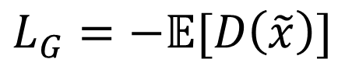
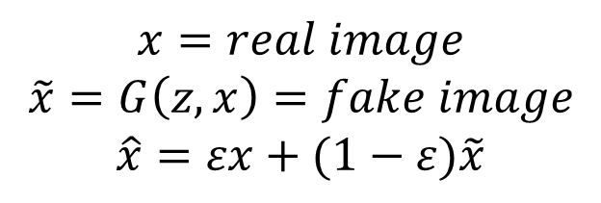
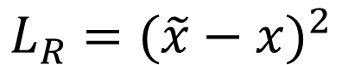
Losses in SINGAN
Generator loss
$$L_{G}=−𝔼[D\left(\tilde{x}\right)]$$
Discriminator loss
$$L_{D}=D\left(\tilde{x}\right)−D\left(x\right)+λ{\left({\left\|∇_{\hat{x}}D\left(\hat{x}\right)\right\|}_{2}−1\right)}^{2}$$
Reconstruction loss
$$x=real image$$
$$\tilde{x}=G\left(z,x\right)=fake image$$
$$\hat{x}=εx+(1−ε)\tilde{x}$$
$$L_{R}={(\tilde{x}−x)}^{2}$$

Slide 7
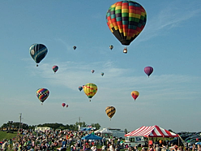
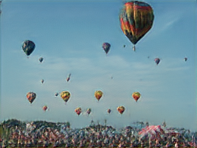
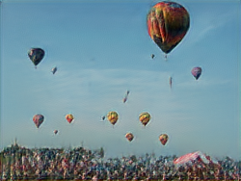
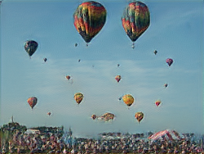
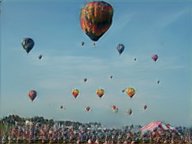
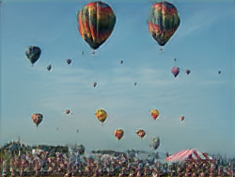
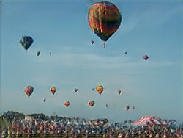
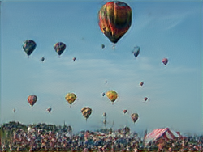
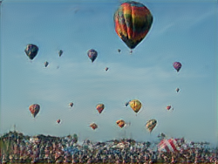
Training image
Scale 0
Scale 1
Replicating paper’s
results:
Scale 2
Scale 3
Scale 4
Random Sample
Scale 5
Scale 6
Scale 7
Baloons in a landscape

Slide 8
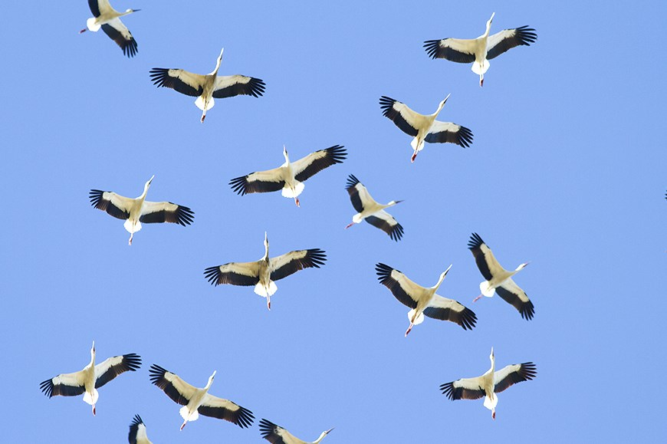
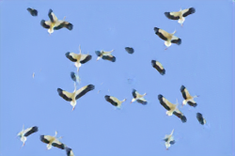
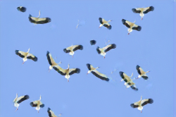
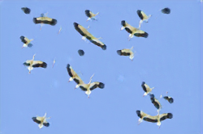
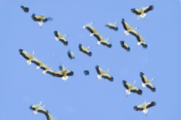
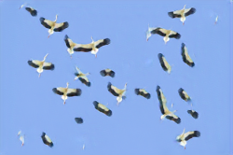
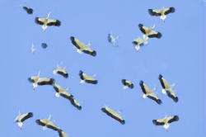
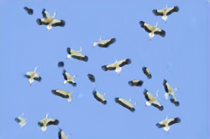
Further example
on natural images:
Training image
Scale 0
Scale 1
Scale 2
Scale 3
Scale 4
Random Sample
Scale 5
Scale 6
Scale 7
Flying birds in the sky

Slide 9
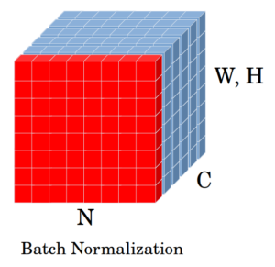
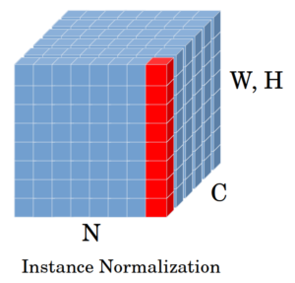
Changes to the original network
Batch normalization→ Instance normalization
In BN, we consider one feature map over all the training sample.
In IN, we consider one training sample and feature map

Slide 10
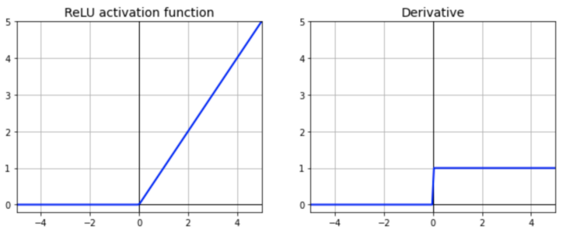
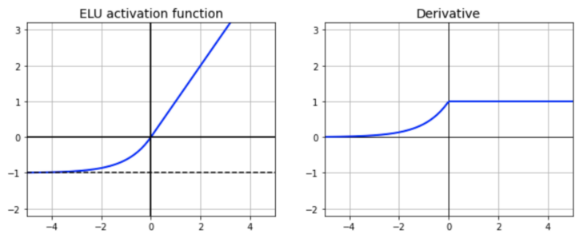
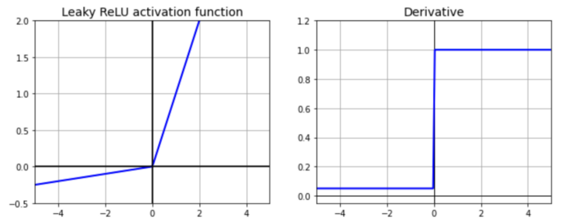
Changes to the original network
ReLU
Exponential ReLU
Leaky ReLU
Activation function
Scale

Slide 11
Metric: SIFID
Fréchet Inception Distance (FID) is a common metric for GAN evaluation that measures the deviation between the distribution of deep features of generated and real images, by using the activation vector after the last pooling layer of the Inception Network.
However, since we have a single training image, we are interested in its internal patch statistics.
In SIFID we use the internal distribution of deep features at the output of the convolutional layer just before the second pooling layer.

Slide 12
Experiments in the Medical Field
Brain MRI
random sample
harmonization
Chest X-ray
random sample
harmonization
Dental radiography
random sample
editing
Femural fracture
editing

Slide 13
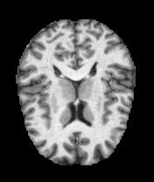
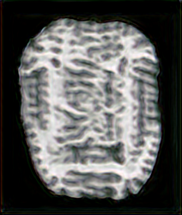
Brain MRI
Random samples
1.5* 10⁻⁴
Training image
Injection at scale 7

Slide 14
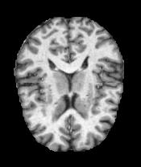
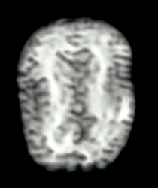
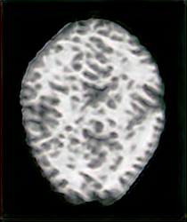
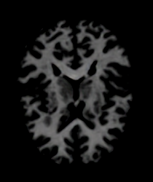
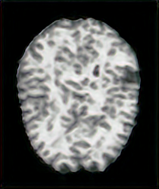
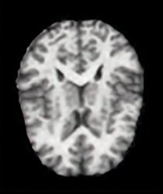
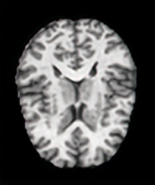
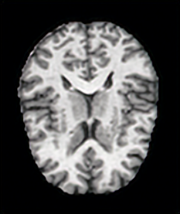
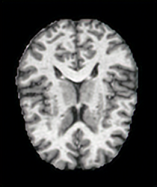
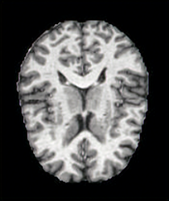
Input image
Scale 0
1.36 * 10⁻⁴
Scale 1
1.56 * 10⁻⁴
Brain MRI
Harmonization
1.75 * 10⁻⁴
Scale 2
1.91 * 10⁻⁴
Scale 3
2.15 * 10⁻⁴
Scale 4
2.15 * 10⁻⁴
Scale 5
2.11 * 10⁻⁴
Scale 6
2.26 * 10⁻⁴
Scale 7
2.21 * 10⁻⁴
Harmonization with injection at scale 3 using batch normalization

Slide 15
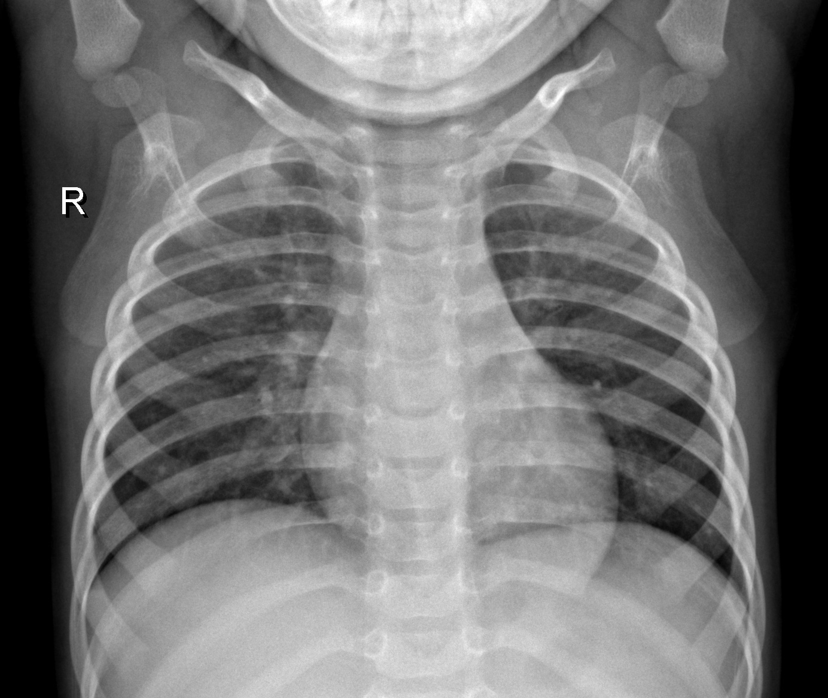
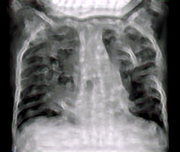
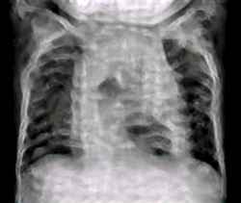
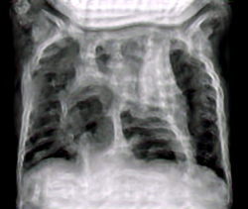
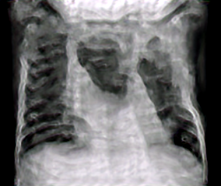
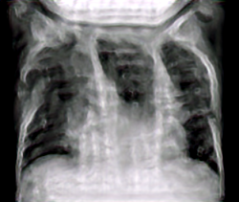
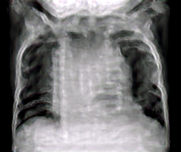
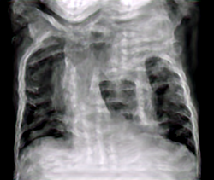

Chest X-ray
Random samples
Training image
Scale 0
2.26 * 10⁻⁴
Scale 1
2.41* 10⁻⁴
Scale 2
1.79 * 10⁻⁴
Scale 3
2.21 * 10⁻⁴
Scale 4
1.81 * 10⁻⁴
Scale 5
2.16 * 10⁻⁴
Scale 6
2.38 * 10⁻⁴
Scale 7
2.71 * 10⁻⁴

Slide 16


















Chest X-ray - Harmonization
Input image
Scale 0
2.17* 10⁻⁴
Scale 1
2.06 * 10⁻⁴
Input image
Scale 0
2.04* 10⁻⁴
Scale 1
2.39 * 10⁻⁴
Scale 2
2.21 * 10⁻⁴
Scale 3
2.51* 10⁻⁴
Scale 4
2.63 * 10⁻⁴
Scale 2
2.54 * 10⁻⁴
Scale 3
2.62 * 10⁻⁴
Scale 4
2.63 * 10⁻⁴
Scale 5
2.74 * 10⁻⁴
Scale 6
2.53 * 10⁻⁴
Scale 7
2.62 * 10⁻⁴
Scale 5
2.59 * 10⁻⁴
Scale 6
2.66 * 10⁻⁴
Scale 7
2.63 * 10⁻⁴

Slide 17










Femural Fracture
Editing
Scale 0
2.14 * 10⁻⁴
Scale 1
2.68 * 10⁻⁴
Scale 2
3.04 * 10⁻⁴
Scale 3
2.87 * 10⁻⁴
Training
image
Scale 4
3.04 * 10⁻⁴
Scale 5
3.02 * 10⁻⁴
Scale 6
3.06 * 10⁻⁴
Scale 7
2.90 * 10⁻⁴
Input
image

Slide 18









Dental Radiography
Random samples
Training
image
scale 0
4.66 * 10⁻⁴
scale 1
4.64 * 10⁻⁴
scale 2
4.81 * 10⁻⁴
scale 3
4.89 * 10⁻⁴
scale 4
4.56 * 10⁻⁴
scale 5
4.57 * 10⁻⁴
scale 6
4.79 * 10⁻⁴
scale 7
4.39 * 10⁻⁴

Slide 19









Dental Radiography
Editing
Input
image
scale 0
5.83 * 10⁻⁴
scale 1
7.21 * 10⁻⁴
scale 2
7.73 * 10⁻⁴
scale 3
7.58 * 10⁻⁴
scale 4
7.33 * 10⁻⁴
scale 5
6.97 * 10⁻⁴
scale 6
6.15 * 10⁻⁴
scale 7
4.45 * 10⁻⁴

Slide 20
Conclusions
Random samples: not satisfactory
Harmonization - Editing: good results, but in most cases requires manual interventions on the image

